Slide 1
BUILD & DEVOPS TOOLS IDENTIFICATION

Slide 2
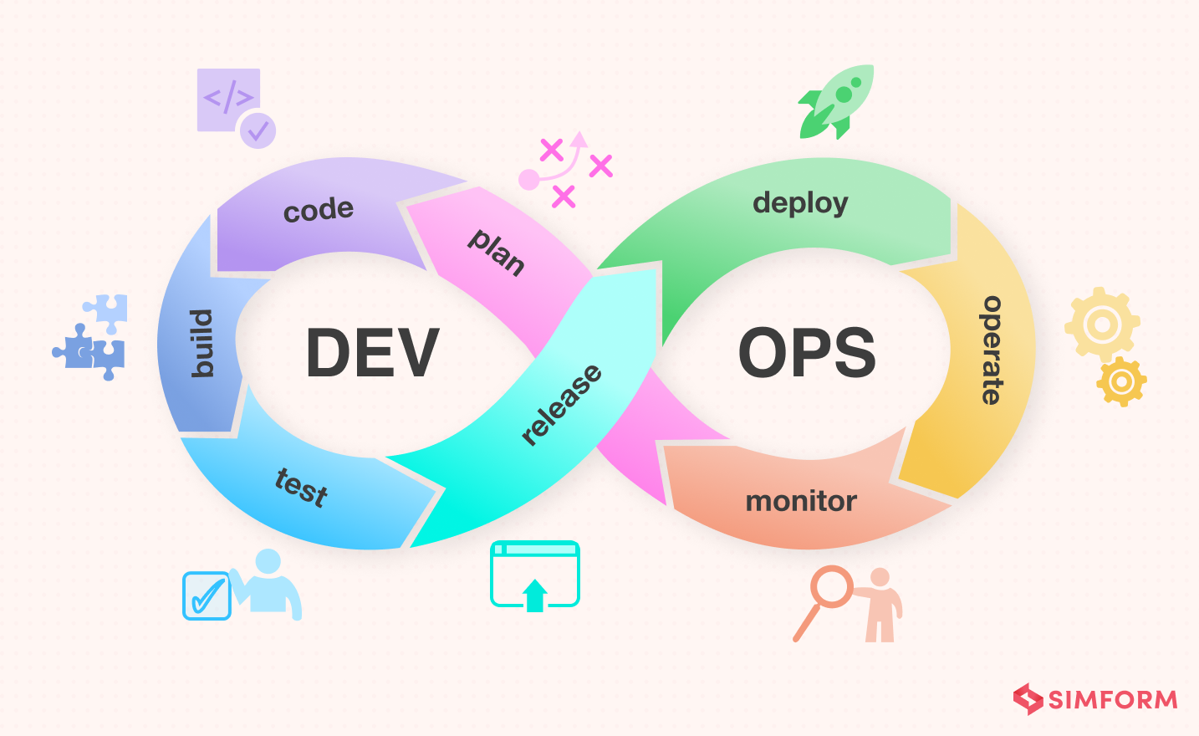
DEVOPS LIFECYCLE

Slide 3
CONTINUOUS INTEGRATION
This stage is the heart of the entire DevOps lifecycle. It is a software development practice in which the developers require to commit changes to the source code more frequently. This may be on a daily or weekly basis. Then every commit is built, and this allows early detection of problems if they are present. Building code is not only involved compilation, but also includes unit testing, integration testing, code review, and packaging.
The code supporting new functionality is continuously integrated with the existing code. Therefore, there is a continuous development of software. The updated code needs to be integrated continuously and smoothly with the systems to reflect changes to the end users.
Jenkins is a popular tool used in this phase. Whenever there is a change in the Git repository, then Jenkins fetches the updated code and prepares a build of that code, which is an executable file in the form of war or jar. Then this build is forwarded to the test server or the production server.

Slide 4
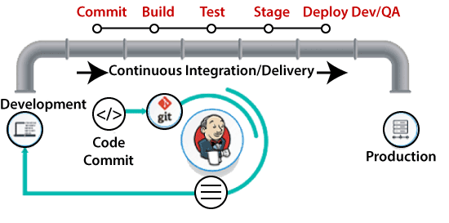

Slide 5

JENKINS
Jenkins is an open-source automation tool written in java with plugins built for Continuous Integration.
Jenkins is used to build & test your software projects continuously making it easier for developers to integrate changes to the project and making it easier for users to obtain a fresh build.
Jenkins → Build → Maven
Jenkins → Version Control System → Git
Jenkins → Continuous Monitoring → Nagios
Jenkins → Continuous Deployment → Ansible
Jenkins → Configuration Management → Puppet
Jenkins → Continuous Testing →Se

Slide 6
BUILD & DEPLOYMENT PROCESS
Source code management tools like GitHub, Bitbucket, and GitLab.
Then compile project source code.
Then Execute unit test cases.
Perform code review using SonarQube.
Package the application (Jar/War) file.
Upload build artifact in Nexus.
Deploy the application on the server.

Slide 7
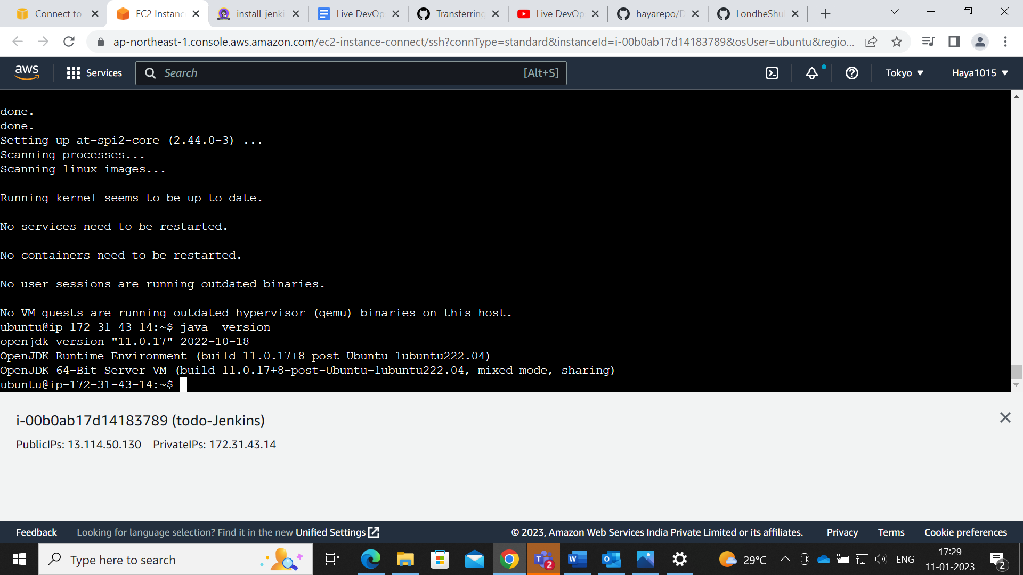
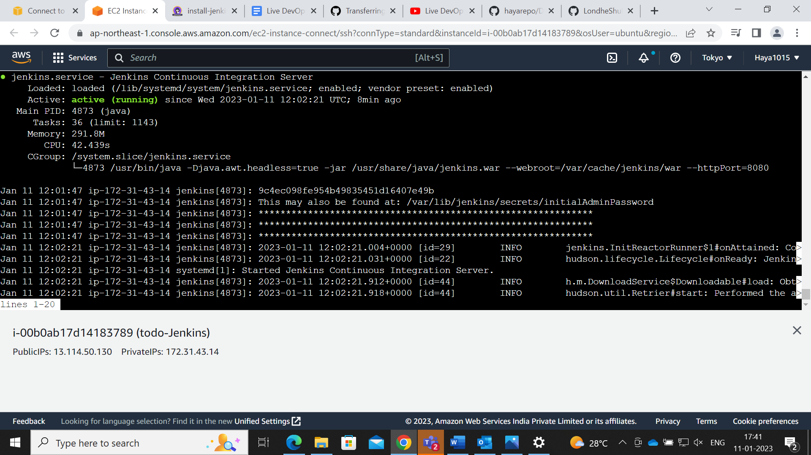
Work Process Of Jenkins Through A Demo

Slide 8
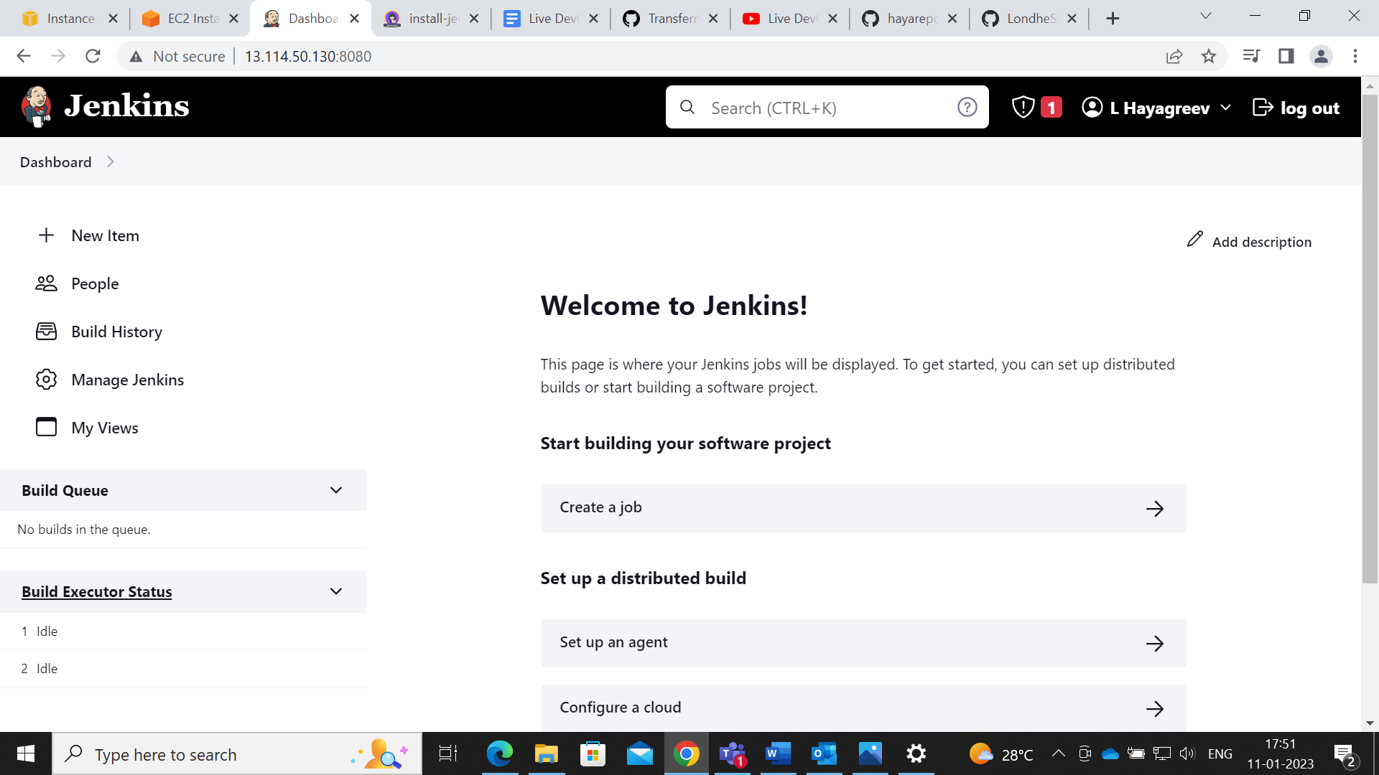
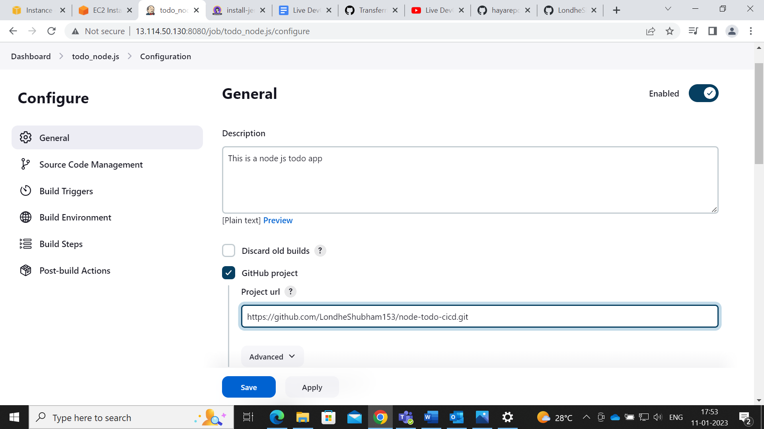
Jenkins Dashboard

Slide 9
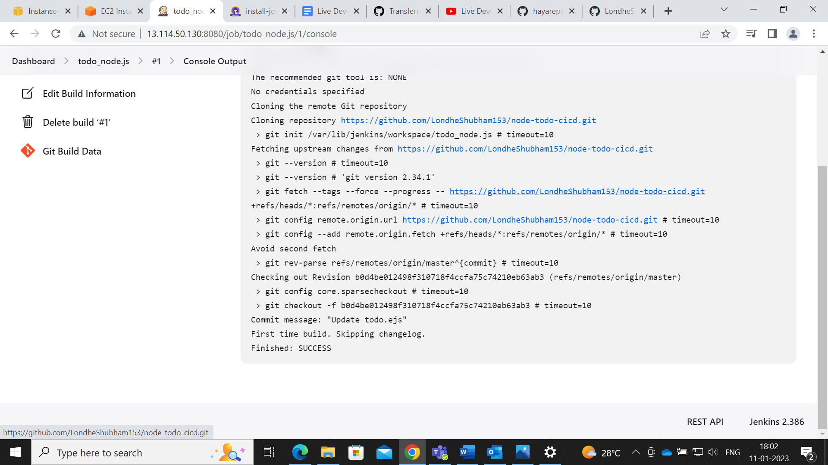
Console Output Of Build

Slide 10
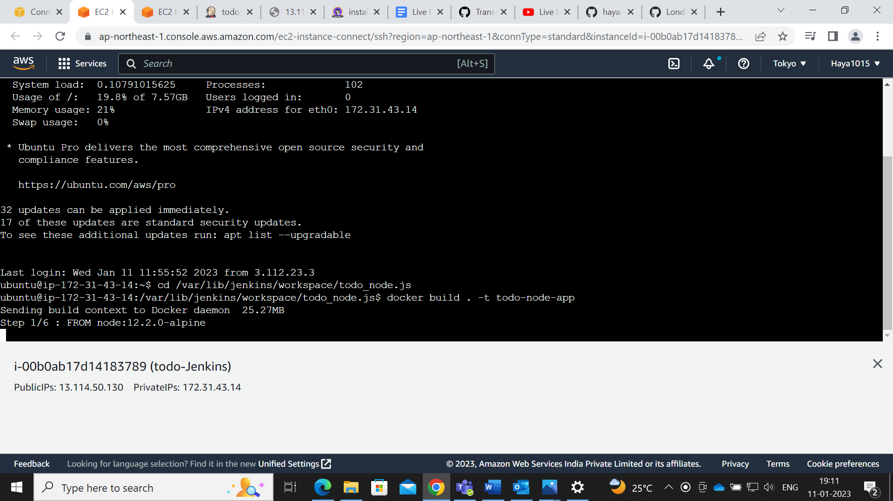
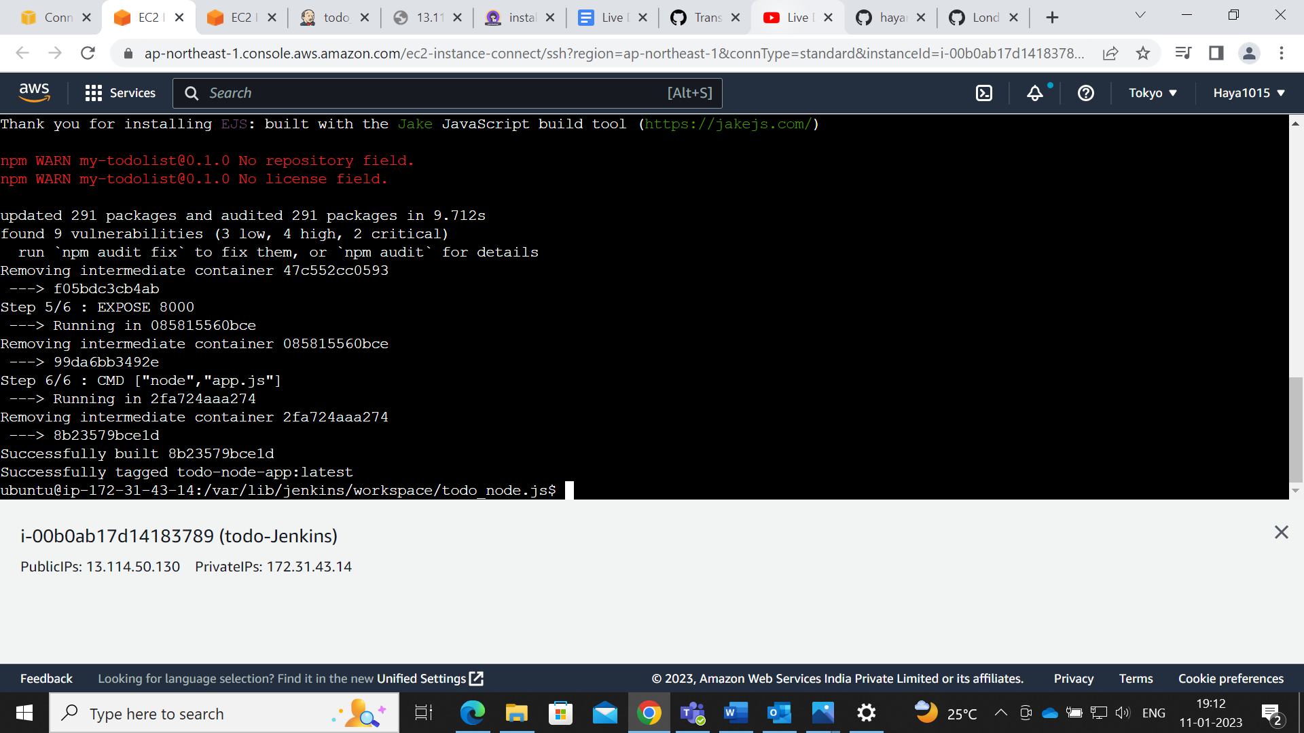
Create a Docker file By Installing Docker on Linux Machine

Slide 11
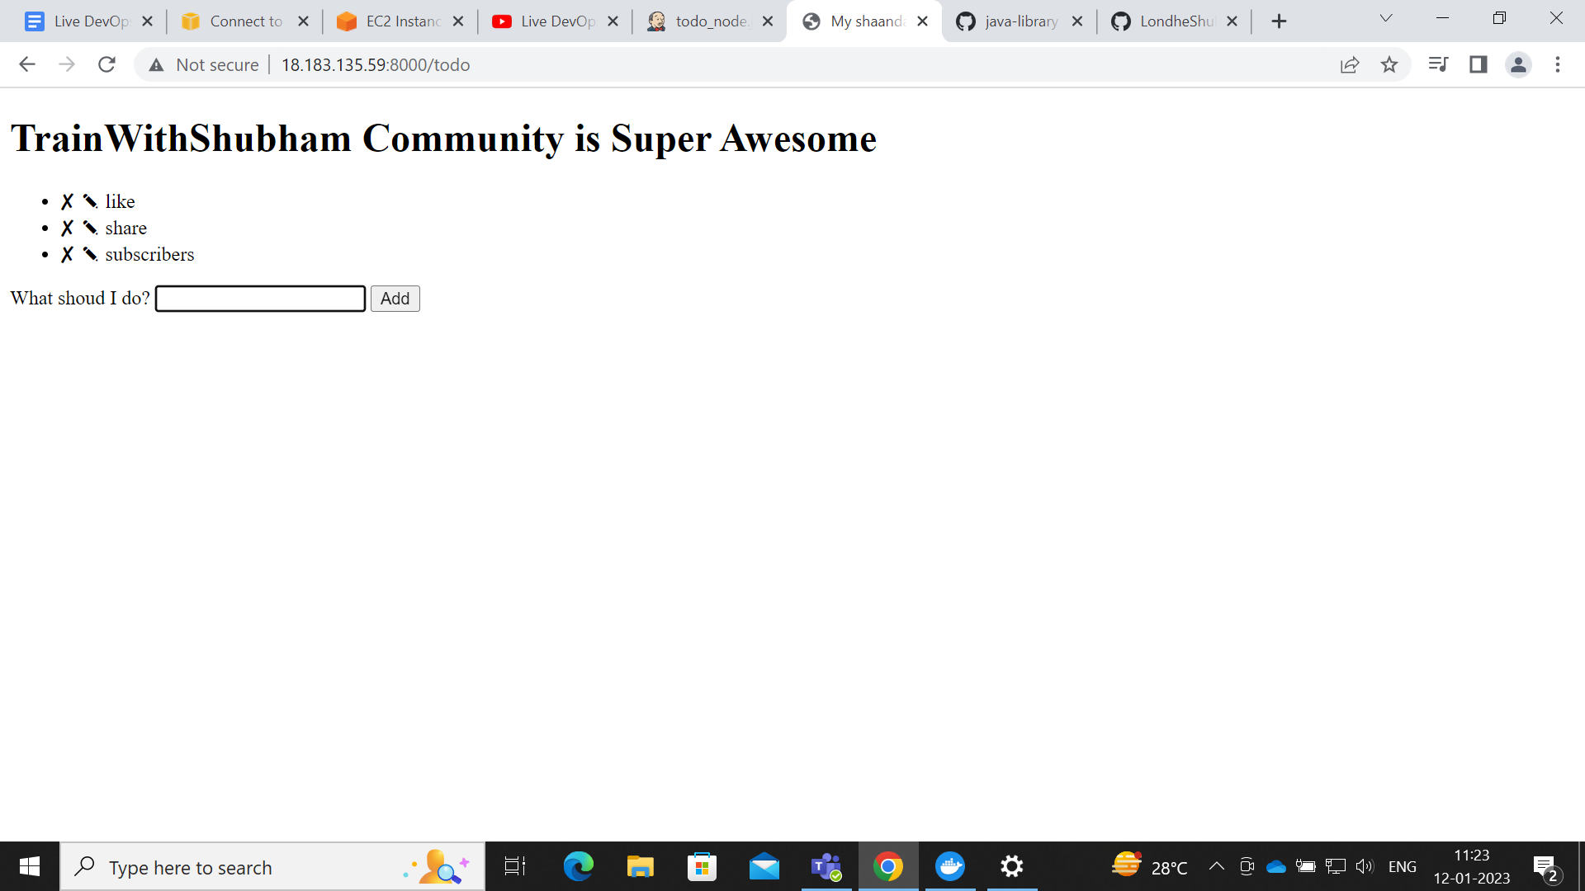
Todo-Node-App Output

Slide 12


